Slide 1

The minor prophets
our new Summer series …

Slide 2

1) Warning of impending judgment because of the nations’ sinfulness
2) A description of the sin
3) A description of the coming judgment
4) A call for repentance
5) A promise of future deliverance.

Slide 3
Hosea 1:1-2
The word of the Lord that came to Hosea, the son of Beeri, in the days of Uzziah, Jotham, Ahaz, and Hezekiah, kings of Judah, and in the days of Jeroboam the son of Joash, king of Israel.
When the Lord first spoke through Hosea, the Lord said to Hosea, “Go, take to yourself a wife of whoredom and have children of whoredom, for the land commits great whoredom by forsaking the Lord.”

Slide 4
The minor prophets
our new Summer series …

Slide 5
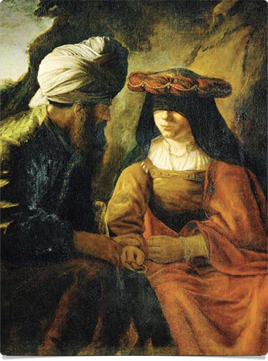
There are two relationships that demand exclusivity
• The relationship between a husband and wife
• And the relationship between
us and God

Slide 6
Hosea 1:2
When the Lord first spoke through Hosea, the Lord said to Hosea, “Go, take to yourself a wife of whoredom and have children of whoredom, for the land commits great whoredom by forsaking the Lord.”

Slide 7
Hosea 1:3
So he went and took Gomer, the daughter of Diblaim, and she conceived and bore him a son.

Slide 8
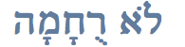
Lo’Ruchamah
lō rü·khä·mä'
“no mercy”

Slide 9
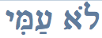
Lo' `Ammiy
lō am·mē'
“not my people”

Slide 10
The minor prophets
our new Summer series …

Slide 11
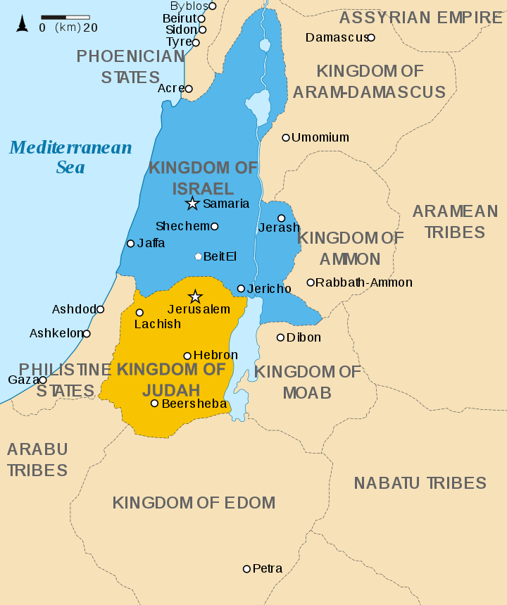

Slide 12
The minor prophets
our new Summer series …

Slide 13
Hosea 2
Say to your brothers, “You are my people,” and to your sisters, “You have received mercy.” “Plead with your mother, plead—for she is not my wife, and I am not her husband—that she put away her whoring from her face, and her adultery from between her breasts; lest I strip her naked and make her as in the day she was born …

Slide 14
Hosea 2
… and make her like a wilderness, and make her like a parched land, and kill her with thirst. Upon her children also I will have no mercy, because they are children of whoredom. For their mother has played the whore; she who conceived them has acted shamefully. For she said, ‘I will go after my lovers, who give me my bread and my water, my wool and my flax,

Slide 15
Hosea 2
Therefore I will hedge up her way with thorns, and I will build a wall against her, so that she cannot find her paths. She shall pursue her lovers but not overtake them, and she shall seek them but shall not find them. Then she shall say, ‘I will go and return to my first husband, for it was better for me then than now.’ And she did not know that it was I who gave her the grain, the wine, and the oil …

Slide 16
Hosea 2
… and who lavished on her silver and gold which they used for Baal. Therefore I will take back my grain in its time, and my wine in its season, and I will take away my wool and my flax, which were to cover her nakedness. Now I will uncover her lewdness in the sight of her lovers, and no one shall rescue her out of my hand. And I will put an end to all her mirth, her feasts, her new moons, her Sabbaths, and all her appointed feasts.

Slide 17
Hosea 2
And I will lay waste her vines and her fig trees, of which she said, ‘These are my wages, which my lovers have given me.’ I will make them a forest, and the beasts of the field shall devour them. And I will punish her for the feast days of the Baals when she burned offerings to them and adorned herself with her ring and jewelry, and went after her lovers and forgot me, declares the Lord.

Slide 18
The minor prophets
our new Summer series …

Slide 19
This book is about three things
• Israel’s unfaithfulness
• God’s judgment
• God’s undeterred love
for His people

Slide 20
The minor prophets
our new Summer series …

Slide 21
This book is about three things
• Israel’s unfaithfulness
• God’s judgment
• God’s undeterred love
for His people

Slide 22
What is whoredom / prostitution?
“A willingness to give away that which is sacred about yourself in order to obtain some temporary, earthly benefit.”

Slide 23
Woe to them, for they have strayed from me!
Hosea 7:13
For Israel has forgotten his Maker …
Hosea 8:14
The more they were called, the more they went away …
Hosea 11:2
My people are bent on turning
away from me …
Hosea 11:7

Slide 24
The minor prophets
our new Summer series …

Slide 25
‘I will go after my lovers,
who give me my bread and my water,
my wool and my flax, my oil and my drink.’
Hosea 2:5
And she did not know
that it was I who gave her …
Hosea 2:8

Slide 26
Israel is a luxuriant vine
that yields its fruit.
The more his fruit increased,
the more altars he built;
as his country improved,
he improved his pillars.
Hosea 10:1
It was I who knew you in the wilderness,
in the land of drought; but when they had grazed, they became full,
they were filled, and their heart was lifted up;
therefore they forgot me.
Hosea 13:5-6

Slide 27
The minor prophets
our new Summer series …

Slide 28
And now they sin more and more,
and make for themselves metal images,
Hosea 13:2
Hear the word of the Lord, O children of Israel,
for the Lord has a controversy with the inhabitants of the land.
There is no faithfulness or steadfast love,
and no knowledge of God in the land;
there is swearing, lying, murder, stealing, and committing adultery;
they break all bounds, and bloodshed follows bloodshed.
Hosea 4:1-2

Slide 29
I know Ephraim,
and Israel is not hidden from me;
for now, O Ephraim, you have played the whore;
Israel is defiled.
Their deeds do not permit them
to return to their God.
For the spirit of whoredom is within them,
and they know not the Lord.
Hosea 5:3-4

Slide 30
This book is about three things
• Israel’s unfaithfulness
• God’s judgment
• God’s undeterred love
for His people

Slide 31
Hosea 5:8-15
Blow the horn in Gibeah, the trumpet in Ramah. Sound the alarm at Beth-aven; we follow you, O Benjamin! Ephraim shall become a desolation in the day of punishment; among the tribes of Israel I make known what is sure. The princes of Judah have become like those who move the landmark; upon them I will pour out my wrath like water. Ephraim is oppressed, crushed in judgment, because he was determined to go after filth. But I am like a moth to Ephraim, and like dry rot to the house of Judah.

Slide 32
Hosea 5:8-15
When Ephraim saw his sickness, and Judah his wound, then Ephraim went to Assyria, and sent to the great king. But he is not able to cure you or heal your wound. For I will be like a lion to Ephraim, and like a young lion to the house of Judah. I, even I, will tear and go away; I will carry off, and no one shall rescue. I will return again to my place, until they acknowledge their guilt and seek my face, and in their distress earnestly seek me.

Slide 33
So you, by the help of your God, return …
Hosea 12:6
Return, O Israel, to the Lord your God …
Hosea 14:1
Take with you words
and return to the Lord …
Hosea 14:2
They shall return and dwell beneath my shadow …
Hosea 14:7

Slide 34
This book is about three things
• Israel’s unfaithfulness
• God’s judgment
• God’s undeterred love
for His people

Slide 35
God’s judgement was certainly coming …
• But God has not abandoned His purpose to save
• God has not abandoned His purpose to have a people who will enjoy the blessing of intimate, exclusive relationship with Him forever!!!

Slide 36
Our only hope …
… is in a love that is not deserved.

Slide 37
Hosea 11:8-9
How can I give you up, O Ephraim? How can I hand you over, O Israel? How can I make you like Admah? How can I treat you like Zeboiim? My heart recoils within me; my compassion grows warm and tender. I will not execute my burning anger; I will not again destroy Ephraim; for I am God and not a man, the Holy One in your midst, and I will not come in wrath.

Slide 38
The minor prophets
our new Summer series …

Slide 39
Hosea 2:14-20
“Therefore, behold, I will allure her, and bring her into the wilderness, and speak tenderly to her. And there I will give her her vineyards and make the Valley of Achor a door of hope. And there she shall answer as in the days of her youth, as at the time when she came out of the land of Egypt. And in that day, declares the Lord, you will call me ‘My Husband,’ and no longer will you call me ‘My Baal.’ For I will remove the names of the Baals from her mouth, …

Slide 40
Hosea 2:14-20
… and they shall be remembered by name no more. And I will make for them a covenant on that day with the beasts of the field, the birds of the heavens, and the creeping things of the ground. And I will abolish the bow, the sword, and war from the land, and I will make you lie down in safety. And I will betroth you to me forever. I will betroth you to me in righteousness and in justice, in steadfast love and in mercy. I will betroth you to me in faithfulness.”

Slide 41
The minor prophets
our new Summer series …

Slide 42
God makes three things plain
• The permanence of the union
• The intimacy of the union
•The fact that the very existence of the union owe’s everything to God

Slide 43
Hosea 2:19-20
And I will betroth you to me forever. I will betroth you to me in righteousness and in justice, in steadfast love and in mercy. I will betroth you to me in faithfulness.”

Slide 44
Hosea 2:20
… you shall know the Lord …

Slide 45
Hosea 2:21-23
“And in that day I will answer, declares the Lord, I will answer the heavens, and they shall answer the earth, and the earth shall answer the grain, the wine, and the oil, and they shall answer Jezreel, and I will sow her for myself in the land. And I will have mercy on No Mercy, and I will say to Not My People, ‘You are my people’; and he shall say, ‘You are my God.’”

Slide 46
Romans 9:23-26
… in order to make known the riches of his glory for vessels of mercy, which he has prepared beforehand for glory— even us whom he has called, not from the Jews only but also from the Gentiles? As indeed he says in Hosea, “Those who were not my people I will call ‘my people,’ and her who was not beloved I will call ‘beloved.’ And in the very place where it was said to them, ‘You are not my people,’ there they will be called ‘sons of the living God.’”

Slide 47
1 Peter 2:10
Once you were not a people, but now you are God’s people; once you had not received mercy, but now you have received mercy.

Slide 48
The minor prophets
our new Summer series …

Slide 49
I will be like the dew to Israel;
he shall blossom like the lily;
he shall take root like the trees of Lebanon;
his shoots shall spread out;
his beauty shall be like the olive,
and his fragrance like Lebanon.
They shall return and dwell beneath my shadow;
they shall flourish like the grain;
they shall blossom like the vine;
their fame shall be like the wine of Lebanon.
Hosea 14:5-7

Slide 50
Hosea 3:5
Afterward the children of Israel shall return and seek the Lord their God, and David their king …

Slide 51
The minor prophets
our new Summer series …

Slide 52
Hosea 14:9
Whoever is wise,
let him understand these things;
whoever is discerning, let him know them;
for the ways of the Lord are right,
and the upright walk in them,
but transgressors stumble in them.

Slide 53
three lessons:
1) Turning away from God turns us to a miserable, wretched, groping after emptiness

Slide 54
three lessons:
2) It is not because of some loveliness in us that God loves us … it is completely by
His grace!

Slide 55
three lessons:
3) No one can love you like God can love you!!!

Slide 56
The minor prophets
our new Summer series …

